Slide 1


Preparing for Your Salesforce Sales Cloud Consultant Certification

Slide 5
Exam Objectives
Industry Knowledge 5%
Implementation Strategies 6%
Sales Cloud Solution Design 25%
Marketing and Leads 7%
Account and Contact Management 12%
Opportunity Management 15%
Sales Productivity 12%
Communities and Site Management 5%
Sales Cloud Analytics 5%
Integration and Data Management 8%
Notes:
Teaching Points:
As you can see, the exam is not evenly balanced across all of these objectives.
The bolded objectives indicate which objective topics are emphasized in this course.
We will cover the bigger objectives (such as Opportunity Management) in dedicated sections. Sales Cloud Solution Design is covered in Module 1.
We will also touch on many of the smaller objectives (such as Sales Cloud Analytics), but they may be incorporated into other sections.
The passing score for the exam is 68%, so we want to make sure you know the bigger objectives really well.
For each section in this course, we’ll show you which objectives we are covering.

Slide 6
Course Agenda
Module 1: Account and Contact Management
Module 2: Campaign and Lead Management
Module 3: Opportunity Management
Module 4: Forecasting
Module 5: Sales Productivity
Module 6: Integration and Data Management
Practice Test

Slide 7
Course Assumptions
Consultants with 2-5 years of experience implementing Sales Cloud solutions.
Salesforce.com Certified Administrator credential is required.
Notes:
The Salesforce.com Certified Consultant program is designed for consultants who have experience implementing Salesforce Sales Cloud solutions.
Certified Sales Cloud Consultants are able to design and implement Sales Cloud solutions that meet business requirements, are maintainable and scalable, and contribute to long-term customer success.

Slide 8
Log in to Salesforce
Log in to Salesforce with your username and password.
URL: login.salesforce.com
Username: admin@salescertprep####.com
Password: (provided by instructor)
Update your name and email address.
Click Admin User | My Profile.
Click the pencil icon next to Contact.
Enter your personal email address.
Click the About tab and enter your first and last name.
Click Save All.
Notes:
Instructor Notes
The ### represents the students’ individual org numbers. This number may be 3, 4, or 5 digits depending on where and when you are teaching this course.
The default password is salesprep2014

Slide 9
Module 1:
Account and Contact Management

Slide 10

Exam Objectives Covered in this Section
Account & Contact Management
Explain how the ownership of account and contact records drive visibility of related sales information such as opportunities, activities, etc.
Explain the various methods for establishing relationships between accounts and contacts.
Explain the impact of having an account hierarchy.
Explain the methods for populating and maintaining account and contact data using data enrichment tools.
Sales Cloud Solution Design
Describe the appropriate use cases for Account and Opportunity Teams and the effect on sales roles, visibility, access, and reporting.

Slide 11


Account and Contact Management
The sales team wants to structure our accounts in Salesforce to reflect how we work with our customers and partners.
Allison Wheeler
VP of Sales
Notes:
Suggestions:
Ask the students what questions they might ask the client to understand how they need to set up accounts and the structure of the clients’ organization(s).
Potential discovery questions:
What industries and types of businesses do you work with?
Who is in your ecosystem? Who do you partner with; who do you work with?
Who are the decision makers? Who are the stakeholders? Who are the users? Then you know who you need to talk to.
What do your decision makers, stakeholders, and various users need to know about each account? (Answer will vary based on the person answering.)
Do you track information about competitors or vendors?
How can you get beyond the question of "what keeps you up at night" to find out how the structure of the company and information is helping customers meet their revenue targets?

Slide 12
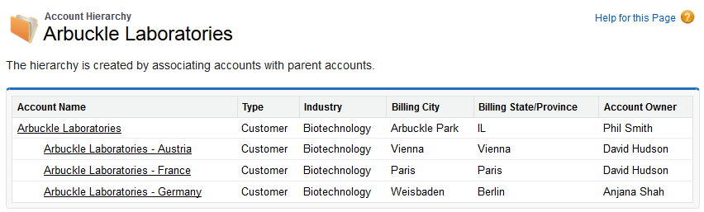
Account Hierarchy
The account hierarchy gives a global view of a company and its subsidiaries by creating an association through the Parent Account field.
Access to child accounts is not granted through account hierarchy.
ALERT:
Notes:
Teaching Points:
“How do accounts get related to each other in Salesforce? Why might you create an account hierarchy?”
Use Account Hierarchy to view the hierarchy of account relationships.
Fill in the Parent Account field to specify that a business account is a subsidiary of another business account.
A combination of the Account Name field and the Account Site field can be used to designate the type of location and the address fields to provide granular location data.
Account hierarchies:
Use standard fields and no custom objects.
Access to child accounts is not granted through account hierarchy.
Provides granular reporting by location, industry, Last Activity and other Account attributes.
Users view only the deals/communications/contacts, etc. related to that location.
Can help organizations with large data volumes address the problem of data skew (e.g., one account having more than 10,000 child records).
Considerations:
You could use a custom object to create these relationships instead of using Account Hierarchy.
What issues may arise with account hierarchy when users don’t have visibility to the parent account? Duplicates, difficulty finding records.
If you need to restrict visibility of accounts, consider displaying a couple of fields to prevent duplicates. Minimized page layouts might be another (less secure) solution.
Users could also run the Account Owner report to see if an account exists and who owns it, but not see any details about the account.

Slide 13
Record Access
Account Teams
Opportunity Teams
Team Sharing
Manual Sharing
Ownership or criteria based
Sharing Rules
P R O F I L E *
Open up access
vertically
Role
Hierarchy
* CRED object settings
Locks down the baseline level of access
Organization-Wide Defaults
* record ownership
Notes:
Teaching Points: Review basics of record sharing and security:
Object access on the profile always trumps record access.
Record owners are granted certain rights to records they own: view, edit, delete, and transfer.
OWDs set the most restrictive access to a record that anyone should have.
Role hierarchy:
Set up role hierarchy based on data access needs, rather than strictly based on an org chart. Ask: who needs to see what data?
Even if OWD is public read/write, there's still a reason to have role hierarchy for things like folder access, etc.
Consider scalability: how will the organization work as it grows?
Use cases for Account and Opportunity teams:
Reps sell in pre-defined teams: a certain group of people works on accounts together (Default Account Team).
Spontaneous teams are created based on who’s available or who is an expert.

Slide 14
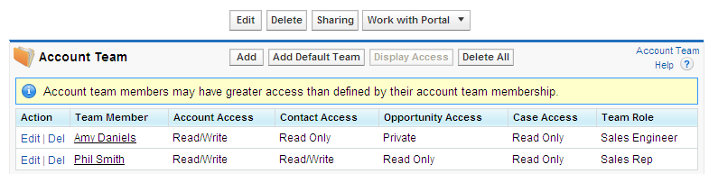
Account Teams
Account teams allow users to grant team members access to a specific account and its related contacts, opportunities, and cases.
Notes:
Teaching Points:
Account Teams allow users to grant additional access to their accounts and related records.
A user can create account teams for the accounts they own that include team members who need access to the account.
The user can assign the access for accounts and the related contacts, opportunities, and cases. Each member can be assigned a team role.
Each user can set up a default account team that defines the members they typically work with on accounts, which can be automatically added to accounts created by a user.
Set the type of access each account team member should have to the account’s related records (you cannot provide access that is more open than your organization’s default settings to accounts–OWD and profile permissions will prevail).
Using account teams allows users to run reports to find out how many account teams a user is assigned to, or who the executive sponsors are on accounts, etc.

Slide 15
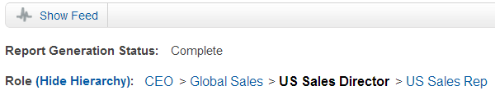
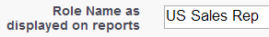
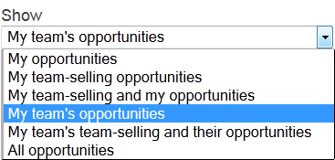
Filtering reports by team
If your organization’s role hierarchy uses roles to represent teams, there are a number of report filters you can use to display data for a particular team.
Role Hierarchy Link: Returns the records that users in the role can see, based on the sharing model.
Owner Role Filter: Returns the records owned by users in the role. (Uses the “Role Name as displayed on reports” value from role.)
My Team Show Filter: Returns the records owned by the user viewing the report, or the dashboard running user, and users in the role(s) below.
Notes:
Teaching Points
We’ve already established that the different consumers of this dashboard will need to see different data (VP – all; managers – just their teams). This must first be correctly set up in each source report. This slide presents three different ways of filtering a report based on the role hierarchy. Go through each one and discuss its suitability in this scenario:
Role hierarchy links: These return all records that the users have access to, not just what they own. In a completely private sharing model, this would be just records that the users own, but in a more public model, it would include shared records. Also, this filter is not “dynamic”—the dashboard would only ever show US records, regardless of the running user. These filters are available for opportunity reports only.
Owner Role filter: This is more suitable as it would only return owned records. However, again this filter is not “dynamic”—the dashboard would only ever show US records, regardless of the running user. Point out that the Owner Role field is actually the Role Name as displayed on reports field from the role, not the role Label. So if this field is not populated, the filter will not work!
My Team Show filter: This filter is based on the first object in the report type. So in activity reports, for example, you can filter on “My team’s activities.” This too will only return owned records, but it is also “dynamic” in that the “My” is determined by the user running the report, or the running user of the dashboard. This is the best option for our scenario.
Extra Material
Suggestions

Slide 16
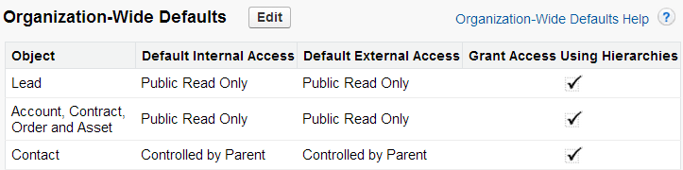
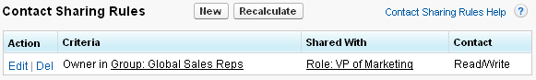
Controlled by Parent Implications
When the organization-wide default for the Contact or Activity object is set to Controlled by Parent, all access to records is determined by the user's access to the parent record.
Sharing rules have no impact when an object is set to Controlled by Parent.
Notes:
Teaching Points
The Contact, Activity, Order and other objects such as Quotes can be set to Controlled by Parent.
In this example, the Contact object is set to Controlled by Parent. This means all access to contacts is controlled by access to the account. Contact sharing rules have no impact.
A Master-detail relationship requires that the child object is automatically set up with Controlled By Parent.

Slide 17
What Solution Would You Recommend?
In an org with a private sharing model, a sales engineer needs access to all opportunities for the American Bank account.
The sales team wants to report on annual revenue for companies and their subsidiaries.
Sales reps need access to contacts based on their access to the associated account.
Solution:
Solution:
Solution:
Notes:
Teaching Points:
For each business requirement, ask the students what elements they would include in a solution. This may be a discussion about what considerations and factors should be considered in cases where there are multiple potential solutions.
Requirement: In an org with a private sharing model, a sales engineer needs access to all opportunities for the American Bank account.
Solution: The best solution is to add the sales engineer to the account team with the appropriate access to accounts, contacts, opportunities, and cases.
Requirement: The sales team wants to report on annual revenue for companies and their subsidiaries.
Solution: Use account hierarchies to link accounts to their parent accounts using the Parent Account field.
Requirement: Sales reps need access to contacts based on their access to the associated account.
Solution: Set the organization-wide default for the Contact object to Controlled by Parent.

Slide 18
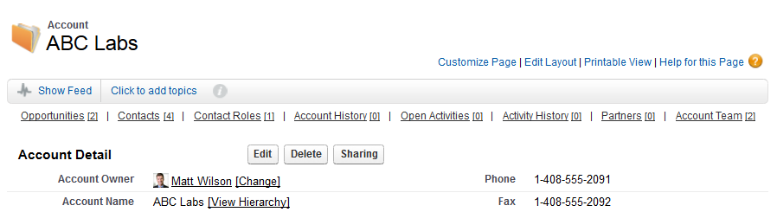
Account and Contact Relationships
Use the related lists on the Account and Contact objects to display related objects.
Customize page layouts to show the information that’s most important to you.
Notes:
Teaching Points:
Once you’ve set up the page layouts, check the search layouts as well: these help a lot with usability and adoption for end users.
Also set up compact layouts if you’re going to be using S1.

Slide 19

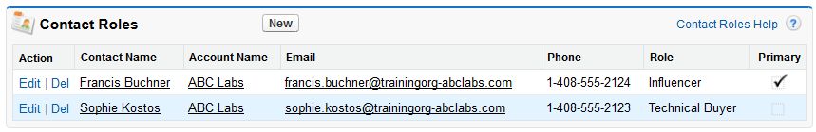
Contact Roles
A contact role defines the part that a contact plays in a specific account, opportunity, contract or case.
A contact can be given different roles for different accounts, opportunities, contracts or cases.
ABC Labs
Customize the role values for accounts, opportunities, and contracts.
Notes:
Teaching Points:
On what objects are contact roles used? (Accounts, Opportunities, Contracts, and Cases.)
The example shows the contact roles for the ABC Labs account.
The fields displayed on the Contact Roles related list cannot be customized.
The Contact Role picklist values can be customized separately for Account, Opportunity, and Contract objects.
You can also add contact roles to cases.
What are some ways this might be useful?

Slide 20
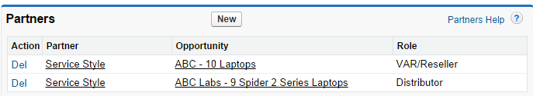
Partner Roles
A partner role defines the part that a partner account plays in a specific opportunity or account.
A partner account can be given different roles for different opportunities or accounts.
When a partner account is added to the Partners related list on an opportunity, the Partners related list on the related account is automatically updated.
ABC Labs
Notes:
Teaching Points:
The example shows the partner roles for the ABC Labs account. Notice that Service Style has the VAR/Reseller role for one opportunity and the Distributor role for a different opportunity.
You can add the Partners related list to account and opportunity page layouts.
You can customize which fields display on the Partners related list. You can display custom and standard field from the related account.
The Partner Role picklist values can be customized for the Account object.

Slide 21
What Solution Would You Recommend?
An account manager wants to track that a contact plays different roles at two different accounts.
The sales team wants to track which partner accounts work on specific opportunities.
Solution:
Solution:
Notes:
Teaching Points:
For each business requirement, ask the students what elements they would include in a solution. This may be a discussion about what considerations and factors should be considered in cases where there are multiple potential solutions.
Requirement: An account manager wants to track that a contact plays different roles at two different accounts.
Solution: Add the contact to the Contact Roles related list on each account with the appropriate role.
Requirement: The sales team wants to track which partner accounts work on specific opportunities.
Solution: Add the partners to the Partners related list on the specific opportunities.

Slide 22
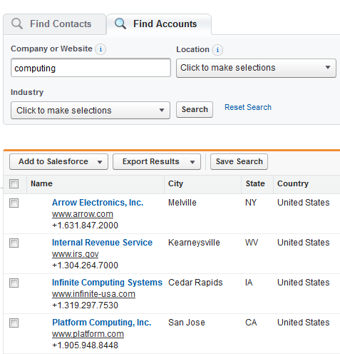
Data.com Prospecting
Data.com Prospector licenses allow users to see complete contact information on individuals and companies that can be entered as leads into Salesforce.
In addition to all Corporate functionality, Data.com Premium Prospector licenses have access to deep account data, including over 80 fields of Dun & Bradstreet firmographic information.
Notes:
Teaching Points
Data.com offers a way to add and update data in Salesforce. It houses millions of contact records sourced from an active community of users who actively update those records with new information.
Users find contacts and D&B company profiles together in one place, so they get current and accurate names, contact information, D-U-N-S® numbers, employee counts, and other information.
Licensing notes:
All organizations will see the Data.com tab and can search for Contacts and Accounts for free - basic information is visible when search results are returned. Detailed contact information for individuals and companies is only provided to licensed users who hold Data.com Prospector and Data.com Clean licenses.
Data.com Prospector provides millions of company records from Dun & Bradstreet. Combining D&B company information with Data.com contact records provides complete account records with over 80 firmographic fields. A user with a Corporate or Premium Prospector license can manually clean records by clicking the Clean button on a contact, lead, or account.
Extra materials:
For organizations looking for in-depth company information, Data.com Premium Prospector users have access to the D&B global file, and over 80 account fields such as DUNS number and NAICS code. When users add an account from Data.com, a corresponding D&B Company record is created. A link to the D&B Company record is also added simultaneously to the account record and any lead records that are added to Salesforce from that company. Instantly access millions of top-quality contacts and D&B company profiles together in one place. You get clean, current, and accurate names, emails, phone numbers, D-U-N-S® numbers, employee counts, and more.

Slide 23
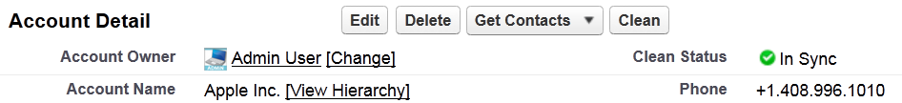
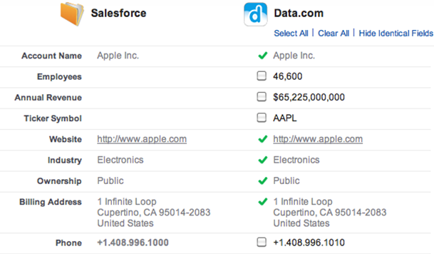

Manually Cleaning Data
Users with Data.com Prospector licenses can manually clean account, contact, and lead records by comparing a Salesforce record side by side with its matched Data.com record and choosing which fields to update.
Clean Status
Enrich
Clean
Notes:
Teaching Points
Cleaning a record can be used by sales reps to make sure a contact’s phone and email address are up to date before contacting them.
Users can enrich their data by populating empty fields in Salesforce with the values from Data.com.
Users can clean their data with the most up-to-date values from Data.com.
A Data.com Corporate or Premium Prospector license is required to manually clean records.

Slide 24
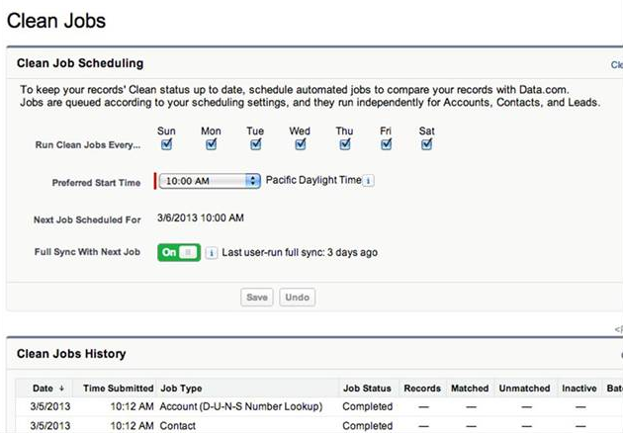
Automatically Cleaning Data
With Data.com Clean, administrators can schedule automatic clean jobs to examine Salesforce account, contact, and lead data on a regular basis, and flag or overwrite records based on selected preferences.
Organizations must purchase Data.com Clean for every Salesforce user to get automated cleaning.
If your organization has purchased Data.com Clean, all Salesforce users (not just those with Data.com Prospector licenses) can manually clean records.
NOTE:
Notes:
Teaching Points
Organizations with Data.com Clean can have their status updated on a regular, scheduled basis and have blank fields automatically filled in with Data.com fields. In order to schedule and run automated clean jobs, organizations must purchase Data.com Clean for every Salesforce user.
Jobs can clean account, contact, and lead records by flagging fields that are different from Data.com values. Users can then compare records and accept changes manually. To save time, you can also elect to have Clean automatically fill in blank values with Data.com fields.
Admins can choose to automatically overwrite fields on contacts, leads, and accounts with Data.com fields. For example, if an organization would like to update all their revenue fields on their lead records, they can select the revenue field on the leads object to overwrite. Then, the Data.com revenue value would replace the Salesforce revenue field value when the next sync job runs. Field History tracking should be enabled when using the auto overwrite feature.

Slide 25
Module 2:
Campaign and Lead Management

Slide 26
Exam Objectives Covered in this Section
Marketing & Leads
Explain how marketing capabilities support the sales process.
Given a scenario, recommend appropriate methods for lead scoring and criteria for lead qualification.
Explain the best practices for managing lead data quality.
Sales Cloud Solution Design
Given a scenario, identify an appropriate approach when designing the lead conversion process.

Slide 27


Campaign and Lead Management
The marketing team wants to run successful campaigns that generate high-quality leads.
Conner McCoy
VP of Marketing
Notes:
Suggestions:
Ask students what questions they might ask the client to understand how they use campaigns and leads?
Potential discovery questions:
How do you measure campaign success?
How do you track campaign response?
How do you compare results across campaigns?
How do you manage lead data quality?
How do you manage duplicate leads?
What process do reps use to qualify a lead for sales?
Is there a common understanding between Marketing and Sales around the process and the stages of lead qualification?
How do handoffs occur between Marketing and Sales?
What campaign and lead metrics are important to you?

Slide 28



Campaigns and Campaign Members
Tracking campaigns enables Marketing and Sales to understand what marketing efforts drive pipeline and revenue.
A campaign has related campaign members who are the target of the campaign.
Campaign Name:
Expected Revenue:
Budgeted Cost:
Actual Cost:
Q1-Spider-Email
$20,000
$5,000
$6,500
Campaign Members
Name: Kelly Herson
Company: American Bank
Status: Accepted
Lead
Contact
Name: Sara Lyons
Company: Fizzing Cola
Status: Attended
Person Account
Name: Adam Avery
Status: Invited
Campaign member fields can be customized to capture the information needed to analyze campaign effectiveness.
Notes:
Teaching Points:
A campaign is a marketing project that you want to plan, manage, and track within Salesforce. It can be a conference, webinar, print advertisement, email, or other type of marketing program.
The campaign stores information, such as start date, end date, expected revenue, budgeted cost, and actual cost.
Tracking campaigns enables Marketing and Sales to understand what marketing efforts drive pipeline and revenue.
A campaign has related campaign members who are the target of the campaign. A campaign member can be a lead, contact, or person account. The campaign member stores information such as name, company, and status.
Campaign member object helps you capture information that allows you to analyze your marketing reach.
You can customize what you capture about campaign members so you can analyze success and design campaigns more effectively. For example, you might want to capture geography, industry, title, etc.

Slide 29

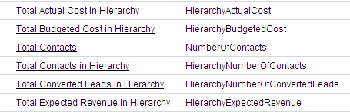
Campaign Hierarchy
Analyze related marketing efforts more efficiently by using campaign hierarchy to group campaigns together within a specific program.
Program: Q1-Spider
Campaign Name | Value Won Opportunities | Value All Opportunities | Expected Revenue
Q1-Spider: Email | $11,000 | $29,000 | $45,000
Q1-Spider: Webinar | $5,000 | $14,000 | $25,000
Program total: | $16,000 | $43,000 | $70,000
Calculate statistics about campaigns in the program using campaign hierarchy fields.
Notes:
Teaching Points:
Campaign hierarchy allows Marketing to group campaigns together within a specific program. This enables Marketing to analyze related marketing efforts more efficiently.
The Campaigns object contains several standard fields that are used for campaign hierarchy. E.g., the “Total Leads in Hierarchy” field displays the total number of leads for the parent campaign and all campaigns below it in the campaign hierarchy.
To run multiple campaigns under one program and calculate the highlighted statistics about the campaigns in the hierarchy, add the campaign hierarchy fields to the page layout for program campaigns. Then set the field-level security to visible for these hierarchy fields.

Slide 30

Campaign Influence
Track the influence of multiple campaigns on a single opportunity with campaign influence.
Opportunity
Telemarketing Campaign
Email Campaign *
Tradeshow Campaign
* Primary Influence
Use opportunity contact roles and other criteria to associate opportunities to campaigns automatically.
Use campaign influence time frame to set the time frame during which a campaign is considered influential.
Notes:
Teaching Points:
Campaign influence allows marketing to track the influence of multiple campaigns on a single opportunity.
The Primary Campaign Source field on an opportunity detail page allows you to designate the most influential campaign for that opportunity.
Influential campaigns can be associated to opportunities manually or automatically. It's the most recent campaign before it's converted OR takes the contacts primary campaign source
When using Campaign Influence, the opportunity is automatically added to the primary campaign.
If enabled, automatic association will add influential campaigns to opportunities when the campaign is related to a contact that is assigned a contact role on the opportunity prior to the opportunity close date.
You can specify additional automatic association criteria, including a campaign influence time frame that limits the amount of time a campaign can influence a new opportunity after the campaign first associated date and before the opportunity created date.
Campaign influence time frame sets the maximum number of days between the campaign first associated date and the opportunity created date, during which a campaign is considered influential. Campaigns in which a contact became a member within the last 60 days will be added to the campaign influence related list.
Influential campaigns can also be added to opportunities manually by clicking the Add Campaign button in the Campaign Influence related list.
Use the Campaigns with Influenced Opportunities campaign report to view opportunities that have been influenced by multiple campaigns.

Slide 31

Granting Access to Campaigns
Who in the organization should have access to campaigns?
Which users should have the Marketing User checkbox selected on their user records?
Organization-wide defaults
Marketing User
Object permissions
The Marketing User checkbox enables a user to:
Create, edit, delete, and clone campaigns.
Manage campaign members.
Advanced campaign setup.
Sharing rules
Notes:
Teaching Points:
Determine who in the organization should have access to campaigns.
Set the organization-wide defaults for the Campaigns object.
Set campaign sharing rules if needed.
Set the profile permissions for the Campaigns object.
Determine which users should have the Marketing User checkbox selected on their user records. This must be checked even if other profile CRED perms are set correctly!
This checkbox enables a user to create, edit, delete, and clone campaigns.
Manage campaign members.
Edit advanced campaign setup. This assumes that the user has the necessary permissions in the profile.

Slide 32
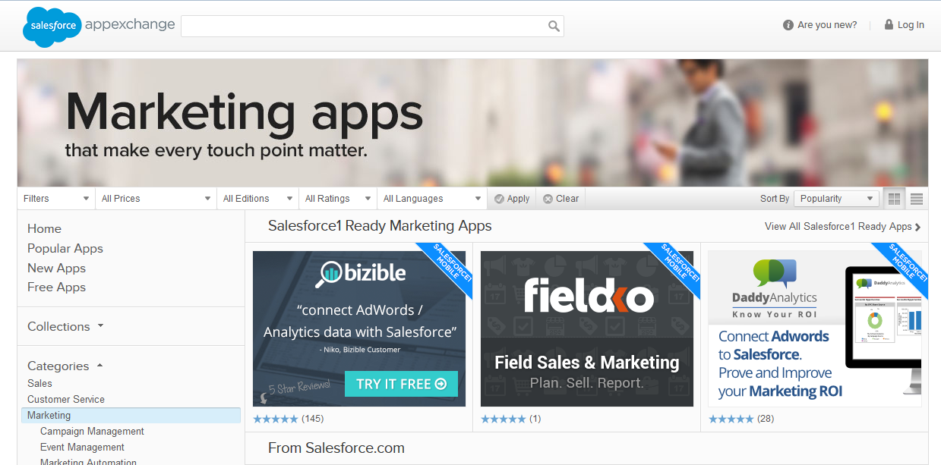
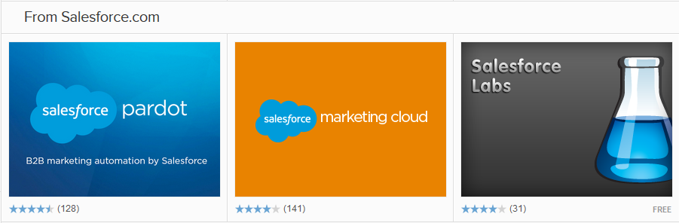
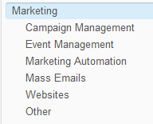
Salesforce AppExchange Marketing Solutions
External marketing solutions let you:
Send mass emails above edition limits (250-1,000 per day).
Track page visits on a website.
Automate marketing activities.
Notes:
Teaching Points:
Use these AppExchange solutions for more complex marketing needs, such as:
Tracking website page visits
Search engine optimization
Mass email campaigns
Marketing automation
Mass email limits vary by edition –250 (PE), 500 (EE) and 1,000 (UE and PXE) per day.

Slide 33
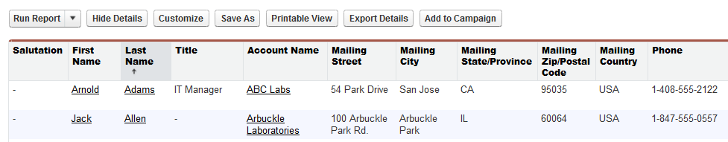
Reporting on Campaigns
You can create reports to analyze campaign members. When a report returns a list of contacts or leads, click Add to Campaign to associate them to an existing campaign.
You can create reports to measure the success of your campaigns:
Campaign pipeline—Value of open opportunities related to a campaign
Campaign revenue—Value of closed won opportunities related to a campaign
Campaign ROI—(Value of won opportunities–campaign cost) / campaign cost

Slide 34
What Solution Would You Recommend?
The marketing director needs to know how different campaigns influence purchasing behavior.
The marketing director needs to know which campaigns have been most cost effective.
The marketing director wants to analyze who has responded to campaigns.
Solution:
Solution:
Solution:
Notes:
Teaching Points:
For each business requirement, ask the students what elements they would include in a solution. This may be a discussion about what considerations and factors should be considered in cases where there are multiple potential solutions.
Requirement: The marketing director needs to know how different campaigns influence purchasing behavior
Solution:
Enable campaign influence and configure influential campaigns to be automatically added to opportunities.
Use the Campaigns with Influenced Opportunities campaign report to view opportunities that have been influenced by multiple campaigns.
Requirement: The marketing director needs to know which campaigns have been most cost-effective.
Solution:
To determine campaign ROI, compare total value of closed/won opportunities with the actual campaign cost.
Run the Campaign Revenue Report to analyze which closed-won opportunities resulted from which campaigns.
Requirement: The marketing director wants to analyze who has responded to campaigns.
Solution:
Add fields to the campaign member object to collect relevant information about prospects.
Run the Campaigns Member Analysis report for summaries of information about leads and contacts who responded to campaigns.
Create target lists for future campaigns based on behavior, geography, industry, title, etc.

Slide 35


Lead Conversion and Campaign Influence
When you convert a lead, Salesforce creates a new account, contact, and optionally, an opportunity using the information from the lead.
Lead
Name: Frank Frederick Company: Allen Brothers Labs
Frank Frederick
Allen Brothers
Follow up with contact
Campaign History
Printer Campaign – Telemarketing
Laptop Campaign – Telemarketing
Opportunity
Opportunity Name: Allen Brothers – 10 Printers Account Name: Allen Brothers
Contact Roles
Frank Frederick
After conversion, lead records are only available through reports.
Campaign Influence
Printer Campaign – Telemarketing (Primary)
Laptop Campaign – Telemarketing
Notes:
Teaching Points:
Every company must come up with Lead Qualification criteria. Once this criteria is met, the lead can be converted. Converting a lead doesn’t mean that the opportunity will be won, but at least we know the prospect is serious.
Lead Qualification criteria example: If the customer has a budget, a need, and an executive sponsor, then the lead can be converted.
When a lead is converted:
A new contact is created.
The contact is attached to an existing account that matches the Lead company or a new account.
A new task is created.
(Optional) A new task is created.
(Optional) A new opportunity is created.
A new contact role is associated to the opportunity.
The campaigns associated with the new contact role are added to the Campaign Influence related list.
After conversion, the record is not available in lead tab but is only available through reporting.

Slide 36
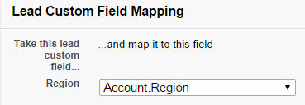
Mapping Lead Fields
Standard lead fields map to standard account, contact, and opportunity fields automatically.
If you have custom fields on the lead object that you want to capture on the converted account, contact, or opportunity:
Create corresponding custom fields on the account, contact, or opportunity object.
Map custom lead fields to custom account, contact, or opportunity fields. Mapped fields should be of the same data type, with few exceptions.
Notes:
There's some of the thought process that needs to happen for the admin process related to lead conversion.

Slide 37
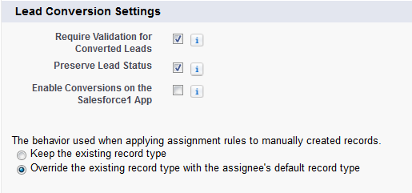
Lead Conversion Considerations
Use the lead settings to specify default lead behavior for your organization.
This includes workflow actions and Apex triggers.
Notes:
Teaching Points:
Require Validation for Converted Leads – When users convert leads, enforce required field settings, field validation rules, workflow actions, and Apex triggers.
Preserve Lead Status – Prevent the lead status from changing to the new lead owner's default value during lead conversion.
The behavior used when applying assignment rules to manually created records.
Keep the existing record type
Override the existing record type with the assignee's default record type

Slide 38
Lead Data Quality
Data Import Wizard
Data.com
Prevent duplicates by checking name, email, or Salesforce ID fields during import
Can invoke active lead assignment rules upon import
Leads missing required field values will not be imported
Clean and enrich lead records in Salesforce with the information from Data.com
Free data assessments show how many of your lead records can be enriched with Data.com Clean
Search for applications that specialize in de-duplicating leads on the AppExchange.
NOTE:
Notes:
Teaching Points:
The matching type you select for an import is used to identify duplicates when you add new records with the import wizard, or to match records when you update existing ones.

Slide 39
What Solution Would You Recommend?
Higher quality lead data would save time and result in more sales.
The Marketing team wants to automate lead processes to save time and ensure consistency.
Marketing and Sales want to generate more leads.
Marketing managers want better visibility into the lead cycle.
Managers want to make sure reps focus on the hottest leads first.
Solution:
Solution:
Solution:
Solution:
Solution:
Notes:
Teaching Points:
For each business requirement, ask the students what elements they would include in a solution. This may be a discussion about what considerations and factors should be considered in cases where there are multiple potential solutions.
Requirement: Higher quality lead data would save time and result in more sales.
Solution:
Validation rules
Workflow field updates
Data.com
De-duplication applications from the app exchange
Schedule data cleansing by administrator or specified user
Build an Apex trigger to prevent a duplicate record from being saved when a lead is created or updated
Requirement: The marketing team wants to automate lead processes to save time and ensure consistency.
Solution:
Set up Web-to-lead automatically capture leads from your website and use auto-response rules to automatically reply to leads
Lead assignment queues.
Workflow rule to assign follow-up tasks, field updates, and alerts.
Workflow to create field updates or transfer leads.
Requirement: Marketing and sales want to generate more leads.
Solution:
Prospect with Data.com.
Capture contact information from people who fill out your web-to lead forms.
Requirement: Marketing managers want better visibility into the lead cycle.
Solution:
Use the lead status field to improve visibility and better manage leads through stages of the lead lifecycle.
Monitor the time it takes to convert leads with the Lead Lifetime report.
Requirement: Managers want to make sure reps focus on the hottest leads first.
Solution:
Prioritize leads with lead scoring - Use a point system to assign values to characteristics that align with successful sales. Consider formula fields for basic demographic scoring. Visit the AppExchange to install the free lead scoring app from Salesforce.com.
Categorize scored leads - Once scored, you can categorize leads into levels of priority, such as A, B, and C.
Route leads using assignment rules - Route qualified leads to the appropriate inside sales rep for further qualification. Assign unqualified leads, such as category C leads, to a marketing queue to be nurtured until they're ready to buy. Also, be sure to create a rule without filters that routes leads to a default user, such as the marketing queue. That way, you can make sure no leads are lost because of gaps in your rules.

Slide 40
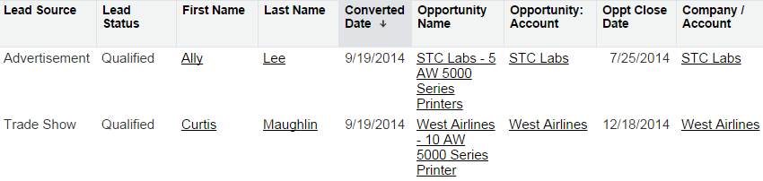
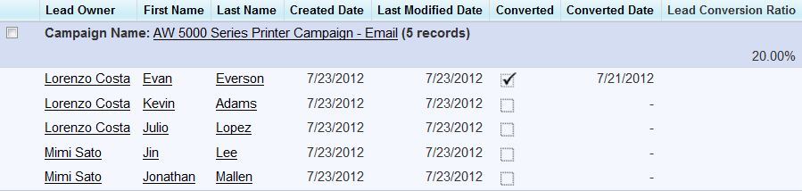
Reporting on Leads
Use the Lead Lifetime report to track the life of a lead from creation to closure.
Use custom summary formulas to calculate summaries of numerical fields, such as the lead conversion ratio.
CONVERTED:SUM/RowCount
Notes:
Teaching Points:
Custom summary formulas only work in summary and matrix reports.

Slide 41
Module 3:
Opportunity Management

Slide 42
Exam Objectives Covered in this Section
Opportunity Management
Given a set of requirements, determine how to support different sales process scenarios.
Describe the relationships between opportunities to assets, product line items and schedules, price books, quotes, contracts, campaigns, etc.
Sales Cloud Solution Design
Given a set of requirements, design an end-to-end sales process from lead to opportunity to quote to close to order.
Given a scenario, analyze customer requirements to determine an appropriate solution design considering capabilities, limitations, and design trade-offs.
Describe the implementation considerations when designing a sales process.

Slide 43

Opportunity Management
The management team wants to define sales processes and generate more revenue.
Allison Wheeler
VP of Sales
Notes:
Suggestions:
Ask the students what questions they might ask the client about existing sales processes and opportunity management.
Potential discovery questions:
What sales strategy do you use?
Do have a standardized sales methodology?
Can you walk me through your sales process?
What business processes do you want to enforce?
What metrics do you need to measure success?
How do your sales strategy and sales methodology work together?
Do you have more than one sales process? What are the stages?
Where would you like to see improvements in your processes?
How are you measuring sales effectiveness?
Discuss common sales KPIs and how they would measure success using features in Salesforce.
Decrease time to close – stage duration, average sales cycle length, activity history
Increase win rate – won opportunities vs. lost opportunities, reasons opportunities are lost, quote to win ratio
Close large deals – opportunity amount, stage

Slide 44
What Solution Would You Recommend?
The sales team needs to follow different processes and track different information depending on whether the sales deal is new or a renewal.
For opportunities that are greater than $1M, sales reps cannot advance the opportunity to the next stage until it has been approved by the regional sales manager.
When an opportunity moves to the Need Analysis stage, sales reps need to schedule a meeting with the customer.
Solution:
Solution:
Solution:
Notes:
Teaching Points:
For each business requirement, ask the students what elements they would include in a solution. This may be a discussion about what considerations and factors should be considered in cases where there are multiple potential solutions.
Requirement: The sales team needs to follow different processes and track different information depending on the whether the sales deal is new or a renewal.
Solution: Create different record types, sales processes, and page layouts for New and Renewal. Assign the sales processes to the corresponding page layouts.
Requirement: For opportunities that are greater than $1M, sales reps cannot advance the opportunity to the next stage until it has been approved by the regional sales manager.
Solution:
Create a custom “Approved” checkbox field on the opportunity to track if the opportunity has been approved. Set the field-level security to read-only for sales reps.
Create a validation rule to ensure that the Stage field cannot advance unless the “Approved” checkbox field is set to True.
OR
Create a single step approval process that requires approval from the regional sales manager. Set the entry criteria to use the approval process if the opportunity Amount is greater than $1M. Set the final approval actions to set the “Approved” checkbox field to True.
Requirement: When an opportunity moves to the Need Analysis stage, sales reps need to schedule a meeting with the customer.
Solution: Use a workflow rule to assign a task to the sales rep.

Slide 45

Analysis
Allison Wheeler
VP Global Sales
“Sales reps need to generate multiple quotes for customers and track this information in Salesforce.”
Let’s review how products, price books, and quotes work in Salesforce.

Slide 46
Products and Price Books
Products and price books track products and services and the various prices at which they are sold.
Products can be categorized into product families.
Products: The individual items or services you sell.
Price Book: The list of products and their associated prices.
Price Book
Name
Code
Price
Product Family
Product A
Product B
Product C
Product D
Product E
PAX2
PBX3
PCX4
PDX5
PEX6
$10
$29
$30
$10
$200
Laptops
Laptops
Laptops
Desktops
Desktops
Product Families: The types of products you sell.
Notes:
Teaching Points:
When forecasting, you can display the expected opportunity revenue or quantity separately for each product family.

Slide 47
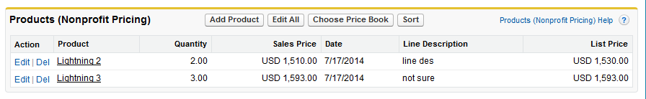
Adding Products to Opportunities
When products are added to an opportunity, they become Opportunity Products.
First, choose a Price Book.
Then, add Products.
From an Opportunity:
Opportunity Products
Once product line items are added to an opportunity, the Opportunity Amount field is automatically populated by the sum of the opportunity products.
NOTE:
Notes:
Teaching Points:
Products added to an opportunity must come from a single price book. The price book entry options available to select will match the currency set on the opportunity.
Once product line items are added to an opportunity, you can no longer manually control the amount of the opportunity. The sum of the Opportunity Products auto-populates the Opportunity Amount field.
An administrator, you can customize Salesforce to:
Prompt users to select a product when they create an opportunity (Setup | Customize | Opportunity | Settings).
Force users to add products when an opportunity is edited using a validation rule, for example when the opportunity stage is moved past Needs Analysis.
Extra materials:
Sometimes Opportunity Products are referred to as Opportunity Line Items or Product Line items – they refer to the same object.

Slide 48


Creating and Synchronizing a Quote to an Opportunity
A quote is created from an opportunity and its products to show proposed prices for products and services.
DEFINITION:
You can create a set of quotes to show different combinations of products, quantities, and discounts.
Opportunity
Quote 3
Product A …. $85
Product B …. $50
Product C …. $120
Product A …. $85
Product B …. $50
Product C …. $120
Quote 2
Quote 1
An opportunity can have multiple quotes, but it can only sync with one quote at a time.
Notes:
Teaching Points:
A quote is a record showing proposed prices for products and services. A quote is created from an opportunity and its products.
When a quote is saved:
A unique quote number is added.
Any products on the opportunity are copied to the quote as line items.
The grand total is recalculated based on any taxes or shipping information you entered.
Multiple quotes can exist on an opportunity, but only one quote can be synced to an opportunity at a time.
When you sync a quote to an opportunity for the first time, the products on the quote are copied to the opportunity.
If you change the quote that syncs to the opportunity, the opportunity will be updated with the products and prices listed on the synced quote.
Quotes syncing lets you link a quote to the opportunity it was created from and synchronize all updates between the two records.
When a quote and an opportunity are synced, any change to line items in the quote will sync with products on the opportunity, and vice versa.
If you’ve made any changes to the quote since you created it from the opportunity, the opportunity will be updated when you sync.
When your quote is complete, generate a PDF using the “Create PDF” button at the top of the quote, and email it to your customer.

Slide 49
Solution Design
Allison Wheeler
VP Global Sales
“Sales reps need to generate multiple quotes for customers and track this information in Salesforce. ”
What solution would you recommend to meet this business requirement?
Notes:
Teaching Points:
Solution:
Implement products and price books.
Enable quotes.
Help the client define a quote generation process that includes generating multiple quotes, syncing quotes, and generating a PDF to email to the customer.

Slide 50
Module 4:
Forecasting

Slide 51
Exam Objectives Covered in this Section
Opportunity Management
Given a scenario, determine the relationships between sales stages, forecast, and pipeline.
Given a set of requirements, determine the appropriate forecasting solution.

Slide 52

Forecasting
The management team wants to generate accurate forecasts and track quota attainment.
Allison Wheeler
VP of Sales
Notes:
Suggestions:
Ask the students what questions they might ask the client to discover forecasting business requirements.
Potential discovery questions:
Do you want to forecast by revenue, quantity, or both?
Do you want to forecast based on the roll-up of opportunities?
Do you want to forecast by product family?
Do you want to include opportunity splits in the forecast?
Do you want to forecast based on opportunity currency fields other than Amount?
Do you want to forecast quarterly or monthly?
Do you want to track quotas and the percentage of quota attainment?

Slide 53

What Makes Up a Forecast?
A forecast is an expression of the expected sales revenue or projected number of units sold based on opportunities in the pipeline.
DEFINITION:
Opportunity Owner
Amount
Quantity
Close Date
Stage
Forecast Category
Matt Wilson
$20,000.00
20
10/17/2014
Prospecting
Pipeline
Matt Wilson
$15,000.00
10
11/28/2014
Id. Decision Makers
Commit
Matt Wilson
$35,000.00
30
12/13/2014
Closed Won
Closed
$70,000.00
60
Forecast Period
The opportunity Stage determines the Forecast Category.
Revenue Forecast
Quantity Forecast
Notes:
Teaching Points:
Let’s assume that Matt Wilson has three opportunities in the sales pipeline.
For each opportunity record, Matt captures the opportunity amount in the Amount field. Revenue Forecast is the total amount of opportunities in the sales pipeline. In this example, Matt’s revenue forecast is $70,000.
Matt uses the opportunity Quantity field to capture the number of units being sold. Quantity forecast is the total number of units across opportunities in the sales pipeline. In this example, Matt’s quantity forecast is 60 units.
The Close Date field determines the Forecast Period.
The Stage field determines the value of the Forecast Category.

Slide 54
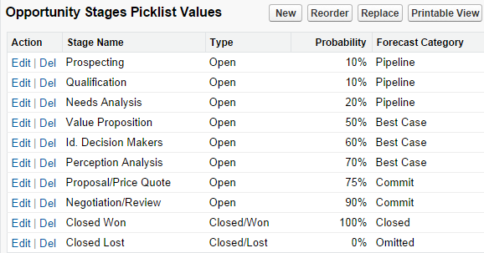
Opportunity Stages and Forecast Categories
The Opportunity Stage controls the Type, Probability, and Forecast Category.
Properly mapping the opportunity Stage to the Forecast Category ensures forecast accuracy.
Notes:
Teaching Points:
Forecast categories group opportunities together based on opportunity stage. An administrator defines which opportunity stages map to each forecast category. The Forecast Category values are Pipeline, Best Case, Commit, Closed, and Omitted.
It is important for you to discuss the opportunity stage and forecast category with sales executives and managers. Sales executives and managers can leverage this to manage their sales teams and ensure forecast accuracy. For example, when a sales rep puts an opportunity in the Commit forecast category they are essentially signing it in blood that this deal will come through!

Slide 55
Considerations When Mapping Opportunity Stages
Opportunities in the Omitted forecast category are not included in the forecast.
The Probability field is merely a gauge for estimating the likelihood that a deal will close.
It is not tied to the amount of the deal.
It is not reflected in the opportunity revenue forecast.
The Expected Revenue field is a standard opportunity field which multiplies the Amount and Probability fields.
By default, this field is not on the standard Opportunity page layout, but you can add it.
This field can be used in custom reports and dashboards.
When using Collaborative Forecasts, this field can be displayed on the forecast.
Notes:
Teaching Points:
Opportunities in the Omitted forecast category are not included in the forecast, since these are typically lost opportunities.
When using Customizable Forecasting, the Expected Revenue field cannot be displayed on the forecast.

Slide 56
Forecasting Capabilities
Display the revenue or quantity based on opportunities in the pipeline.
Display the revenue or quantity for each product family.
Display monthly or quarterly forecasts.
Include partner-owned opportunities in the forecast.
Show the opportunities included in the forecast.
Support multiple currencies.
Display quotas and quota attainment for both revenue and quantity.
Allow managers to adjust the forecast to increase accuracy.
Use the forecast hierarchy and forecast managers to control access to forecast data.
Supports custom fiscal years.
Notes:
Teaching Points:
These capabilities are common to both Customizable Forecasting and Collaborative Forecasts.
When talking about adjustments, Customizable Forecasting using the term “override,” whereas Collaborative Forecasts uses the term “adjust.”
Forecasts use static exchange rates – they do not use dated exchange rates from Advanced Currency Management.

Slide 57
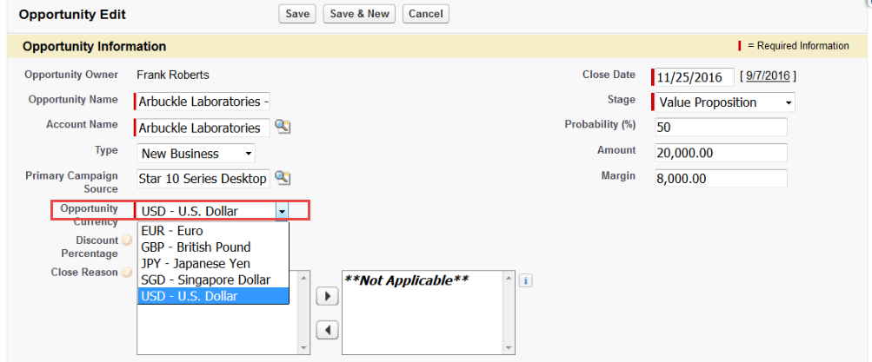
Advanced Currency management
Currency of opportunity using active currency on the user record.
Amount fields will reflect currency on the opportunity.
Currency in reporting amount and amount converted in reports is based on the filters.
Multiple currencies have to be enabled, set up, and monitored.
Advanced currency management can be enabled to lock dated exchange rates.
For more information, see About Advanced Currency Management
RESOURCE:
Notes:
Teaching Points:

Slide 58
Customizable Forecasting vs. Collaborative Forecasts
There are two different forecasting options in Salesforce: Customizable Forecasting and Collaborative Forecasts.
When deciding which forecasting option to implement, ask:
Which forecasting option is enabled in your client’s organization?
If your client currently has Customizable Forecasting enabled, should they migrate to Collaborative Forecasts?
Search Help & Training for: What's the difference between the Forecasting features?
RESOURCE:
Notes:
Teaching Points:
These are the questions you should ask when deciding which forecasting option to implement at your client.
Which forecasting option is enabled in your client’s organization? Collaborative Forecasts became generally available in Winter ’12. Customers with orgs provisioned in Winter ‘12 or later have Collaborative Forecasts enabled by default. Customers with orgs provisioned before Winter ’12 have Customizable Forecasting enabled by default.
If your client currently has Customizable Forecasting enabled, should they migrate to Collaborative Forecasts? In the Summer ’14 Release Notes, salesforce.com announced that Customizable Forecasting is no longer in development. Instead, they are focusing their development efforts on Collaborative Forecasts. While they are continuing to support Customizable Forecasting, they have no plans to further develop it. Customers who want to work with the most current and developing forecasting features should consider migrating to Collaborative Forecasts.
Now we’ll take a look at the differences between Customizable Forecasting and Collaborative Forecasts. This will help you decide whether or not your customer can migrate from Customizable Forecasting to Collaborative Forecasts.

Slide 59
Differences: Opportunity Roll Up
Customizable Forecasting:
Cumulative Rollup Only
Collaborative Forecasts:
Choose Individual or Cumulative Rollup
Cumulative Opportunity Rollup
Each forecast category on the forecast displays aggregated opportunity information.
Individual Opportunity Rollup
Each forecast category displays only the opportunities mapped to that category.
Forecast | Opportunity
Closed | Closed
Commit | Closed + Commit
Best Case | Closed + Commit + Best Case
Pipeline | Commit + Best Case + Pipeline
Forecast | Opportunity
Closed | Closed
Commit | Commit
Best Case | Best Case
Pipeline | Pipeline
Note: Only Collaborative Forecasts allow you to change the names of the forecast categories.
Notes:
Teaching Points:
There are two different ways to roll opportunities up to the forecast: cumulatively, or individually.
Customizable Forecasting only allows forecasts to roll up cumulatively. With Cumulative Forecast Rollups:
Forecast columns show cumulative amounts from the opportunities in the named forecast category, as well as subsequent categories in the sales funnel.
The Pipeline column contains amounts for all open opportunities (excluding Omitted).
Cumulative Forecast Rollups make it easier for sales teams to see the total numbers they’re likely to bring in, saving them from combining the category totals themselves.
As of Summer ‘15, organizations using Collaborative Forecasts can choose one of two ways for opportunities to roll up to forecast categories: cumulatively or individually.
The individual forecast method, which rolls up the opportunities from each individual forecast category into separate forecast amounts for each category. E.g., Best Case only reflects amounts in the Best Case category.
With individual forecast category rollups, each total and subtotal represents opportunities from only one of the individual forecast categories.
If forecast users want to know the total that they’re going to actually bring for the month or quarter, they need to add the Best Case, Commit, and Closed forecast amounts together themselves.
Organizations that wish to use Forecast Historical Trending must use individual forecast rollups.
Only Collaborative Forecasts allows you to change the forecast category names for the organization. For example, you could change the “Omitted” forecast category to “Lost.”
Remember that opportunities in the Omitted forecast category are not included in the forecast, since these are lost opportunities. This is true for both Customizable Forecasting and Collaborative Forecasts.
Extra material:
Prior to Summer ‘15, cumulative rollups were only available in Customizable Forecasting.

Slide 60
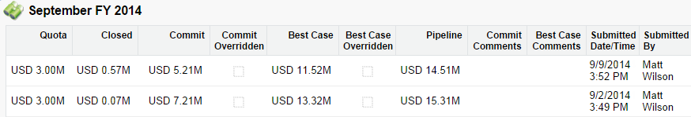
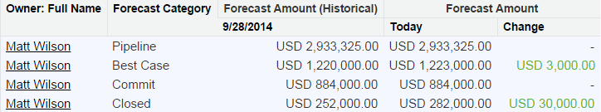
Differences: Historical Data
Customizable Forecasting—Submitting your forecast takes a snapshot of your forecast totals and makes them available in your forecast history and in reports.
Collaborative Forecasts—Historical trending lets you compare how forecasting data looked at specific points in the past. You can display up to five historical dates, displaying data from up to the last three months.
Notes:
Teaching Points:
Customizable Forecasting:
In the example, Matt Wilson submitted his September forecast two times (1 week apart).
Salesforce captures the forecast totals each time he submits the forecast.
The forecast history displays his historical data.
Collaborative Forecasts:
The example shows a forecasting historical trending report for Matt Wilson.
The report shows the historical forecast amount for today and 1 week ago.
The report also shows the change between these values.

Slide 61
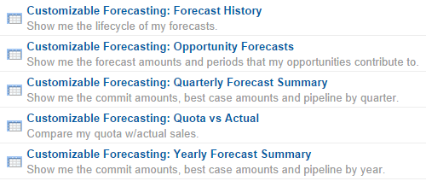
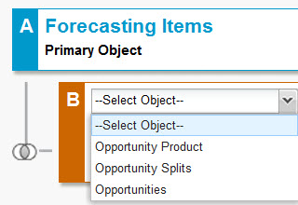
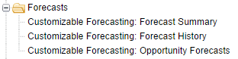
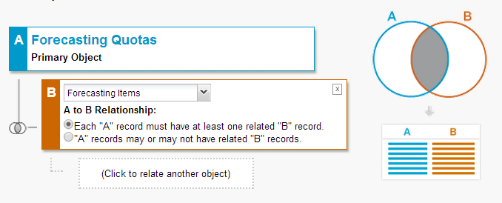
Differences: Reporting
Customizable Forecasting
Includes these standard reports.
Lets you create custom reports using these standard report types.
Does not support custom report types.
Collaborative Forecasts
Does not support standard reports or standard report types.
Only supports custom report types.
Notes:
Teaching Points:
Customizable Forecasting:
There are five standard reports in the Forecast Reports.
You can create your own custom reports using one of the standard report types.
You cannot create custom report types.
Collaborative Forecasts:
You can create a custom report type for Forecasting Items and include related Opportunity Products, Opportunity Splits, or Opportunities.
You can create a custom report type for Forecasting Quotas and include related Forecasting Items. This allows you to use both forecasting and quota fields in the report.

Slide 62
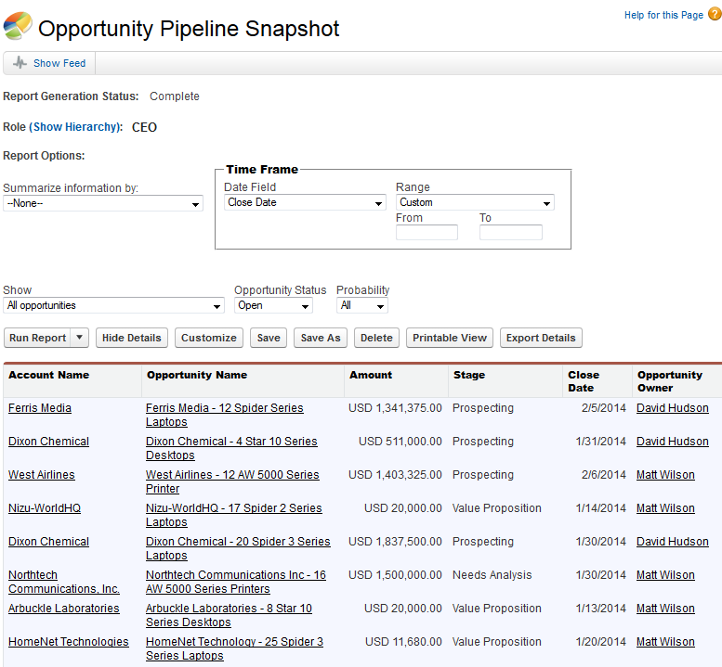
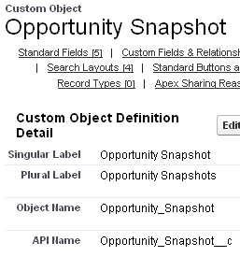
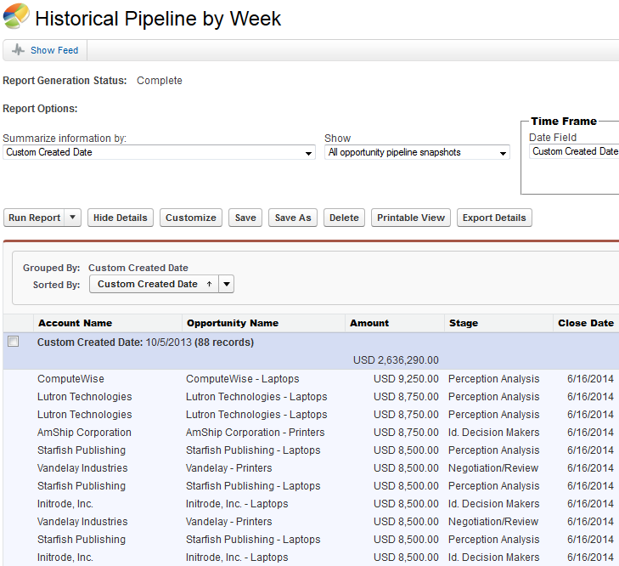

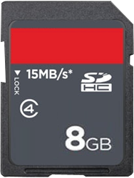

What is a Reporting Snapshot?
Reporting snapshots let you capture data at scheduled points in time, which can later be used to build historical reports.
DEFINITION:
1
2
3
Snapshot taken of data in source report at regular intervals.
Each row saved as record in custom target object.
Build reports to analyze data in target object.
Notes:
Teaching Points: It might help to talk about reporting snapshots using a time-lapse photography analogy. What you are essentially doing is taking a picture of the data in a source report at regular intervals. Each row from the source report is saved in a target object (custom object), just like each photo would be saved on a memory card. The “historical” records can then be later analyzed in reports, just like you would later view your photos in a slideshow.
Reporting snapshots can be run daily, weekly or monthly. The point in time that a snapshot is taken is reflected in the Created Date of the records in the target object. When you build reports on the target object, use the Created Date to filter or group the records to analyze the data by period.

Slide 63
Capabilities Specific to Customizable Forecasting
Supports product schedule forecasts.
Supports Territory Management.
Allows forecast data to be manually shared with other users.
Notes:
Teaching Points:
When using Customizable Forecasting, you can define the fiscal year using standard fiscal years or custom fiscal years.
Customizable Forecasting works with Territory Management. It does not work with Territory Management 2.0.
Starting with Winter ’15, Territory Management 2.0 can be enabled by administrators in new Salesforce organizations. Organizations created before Winter ’15 need to call salesforce.com to enable Territory Management 2.0.
Disabling Customizable Forecasting automatically disables Territory Management in your organization.
With Customizable Forecasting, you can allow administrators and forecast managers to manually share forecast data (using the Sharing button). Like with all manual sharing, you can share with Public Groups, Roles, Roles and Subordinates, and Users.

Slide 64
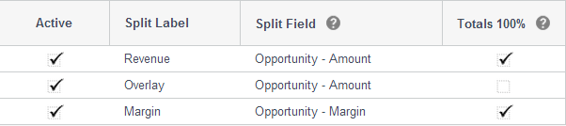
Capabilities Specific to Collaborative Forecasts
Opportunity Splits lets team members share sales credit for an opportunity.
Collaborative Forecasts lets you forecast on:
Expected revenue including the Revenue split amount.
Expected revenue including the Overlay split amount.
Expected revenue from standard or custom opportunity currency fields.
Notes:
Teaching Points:
There are three types of opportunity splits:
Revenue splits total 100% of the opportunity amount. Use Revenue splits to credit team members who are directly responsible for opportunity revenue
Overlay splits total any percentage of the opportunity amount. Use Overlay splits to credit supporting team members. Overlay splits can total percentages over 100%.
Custom splits allow the split to be based on a standard or custom currency field on the opportunity. The example show the Margin custom field. Split types can be based on most opportunity currency fields, including custom fields and roll-up summary fields, but not formula currency fields.
With Collaborative Forecasts, you can forecast on Revenue splits, Overlay splits, and opportunity currency fields.
You can only forecast on revenue (not quantity).
If you do not use opportunity splits on your opportunity currency fields, the opportunity owner automatically receives a 100% split for the field. Your forecast is the same as if there were no splits.
If you use opportunity splits on your opportunity currency fields, your forecast includes the splits.
Suggestions:
Ask students for examples of other standard or custom opportunity currency fields that clients might want to forecast on?
Possible answers: Expected Revenue (standard field), Monthly Recurring Revenue (custom field), Annual Contract Value (custom field)

Slide 65
Summary of Differences
 | Customizable Forecasting | Collaborative Forecasts
Opportunity Roll Up | Cumulative Rollup Only | Individual or Cumulative Rollup
Historical Data | Submit the forecast to make the snapshot available in the forecast history and reports | Use historical trending to compare data from specific points in the past
Reporting | Only supports standard reports and standard report types. | Only supports custom report types.
Unique Capabilities | Product schedule forecasts Territory Management Manual sharing of forecast data | Forecast on Revenue splits Forecast on Overlay splits Forecast on opportunity currency fields

Slide 66
Which Forecasting Solution Would You Recommend?
The sales team wants the forecast to include probability in the revenue calculation.
The sales team wants to forecast based on the expected sales revenue and projected number of units sold each quarter.
The sales team wants to track the percentage of quota attainment for sales reps and managers.
The sales team wants to include opportunity revenue splits in the forecast.
The sales team needs to run custom reports.
Solution:
Solution:
Solution:
Solution:
Solution:
Notes:
Teaching Points:
For each business requirement, ask the students whether they would recommend Customizable Forecasting or Collaborative Forecasts as the solution.
Requirement: The sales team wants the forecast to include probability in the revenue calculation.
Solution: Collaborative Forecasts – The Expected Revenue field is a standard opportunity field which multiplies the Amount and Probability fields. Use Collaborative Forecasts to display the Expected Revenue field in the forecast.
Requirement: The sales team wants to forecast based on the expected sales revenue and projected number of units sold each quarter.
Solution: Customizable Forecasting OR Collaborative Forecasts. Both Customizable Forecasting and Collaborative Forecasts support this requirement. You would need to dig deeper into their requirements to understand which solution to implement.
Requirement: The sales team wants to track the percentage of quota attainment for sales reps and managers.
Solution: Customizable Forecasting OR Collaborative Forecasts. Both Customizable Forecasting and Collaborative Forecasts support this requirement. You would need to dig deeper into their requirements to understand which solution to implement.
Requirement: The sales team wants to include opportunity revenue splits in the forecast.
Solution: Collaborative Forecasts – Use Collaborative Forecasts to display the expected revenue including the opportunity revenue split amount.
Requirement: The sales team needs to run custom reports.
Solution: Collaborative Forecasts – Only Collaborative Forecasts supports custom report types.

Slide 67
Module 5:
Sales Productivity

Slide 68
Exam Objectives Covered in this Section
Sales Productivity
Given a scenario, determine the key features that help to enable and measure sales productivity and adoption.
Identify use cases and considerations for using email and productivity tools.
Given a scenario, identify the appropriate mobile solution to improve sales productivity.
Describe how Chatter enables collaboration in the sales process.
Explain the use cases and best practices for using Content vs. Chatter Files in the sales process.

Slide 69

Sales Productivity
The sales team needs to collaborate and share information to sell more efficiently.
Allison Wheeler
VP of Sales
Notes:
Suggestions:
Ask the students what questions they might ask the client to discover the information reps need to share to work together and sell efficiently.
Potential discovery questions:
What information do reps share when working deals?
How is email used in the sales process?
What do reps need to be more productive on the road?
How do reps communicate with customers?
How do you measure sales performance and productivity?
Extra materials:
Some common sales productivity KPIs and how they would measure success using features in Salesforce:
Reduce time to close a deal - Number of activities by opportunity (Activities with opportunities custom report)
Increase time selling - Number of activities by rep (Activity report), Number of deals won, lost, in-progress (Opportunity report by rep)
Increase number of closed deals - Number of closed won sales deals (Opportunity Pipeline standard report)
The sales team needs to collaborate and share information to sell more efficiently.
Potential discovery questions:
What other questions do you ask to discover the metrics that are important to your client?

Slide 70
What Solution Would You Recommend?
The VP of Global Sales wants to be notified when high-value opportunities reach the later stages of the sales process.
Sales reps want to easily find other opportunities that were won against the same competitors.
The account owner needs to be notified when a new opportunity is created for one of their key customers.
The sales team wants to reduce the time it takes for sales managers to accept or reject discount approvals.
Solution:
Solution:
Solution:
Solution:
Notes:
Teaching Points:
For each business requirement, ask the students what elements they would include in a solution. This may be a discussion about what considerations and factors should be considered in cases where there are multiple potential solutions.
Requirement: The VP of Global Sales wants to be notified when high value opportunities reach the later stages of the sales process.
Solution: Use a big deal alert to automatically notify the VP of Global Sales. A Big Deal Alert is an automated email that includes a snapshot of an opportunity that has reached a given threshold. You can set your threshold by entering a trigger amount and probability. The email will be sent when both triggers are met or exceeded. Note – This could also be done with a workflow rule and an email alert.
Requirement: Sales reps want to easily find other opportunities that were won against the same competitors.
Solution: Use the Similar Opportunities feature to allow users to find Closed/Won opportunities that match the attributes of an opportunity they're currently viewing, and add them to the Similar Opportunities related list on that opportunity's record.
Requirement: The account owner needs to be notified when a new opportunity is created for one of their key customers.
Solution: Create a workflow rule with an email alert.
Requirement: The sales team wants to reduce the time it takes for sales managers to accept or reject discount approvals.
Solution:
Enable Chatter Approvals. This feature allows approval request posts to appear in the Chatter feed. This allows sales managers to approve or reject discount approvals directly from the Chatter feed.
Designate Delegated Approvers who can approve requests on behalf of others who are unavailable or unable to complete the request. This will help to avoid delays if the sales manager is out of town or unable to approve the request.
Enable email approval response. This feature allows approvers and delegated approvers to reply to the approval request email with one of the following words in the email body: APPROVE, APPROVED, YES, REJECT, REJECTED, NO. Approvers and delegated approvers can also add comments in the second line of the response.

Slide 71
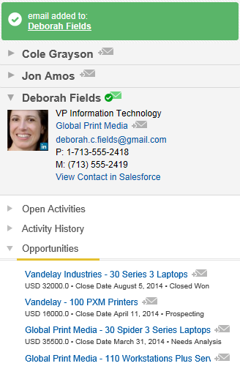
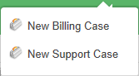
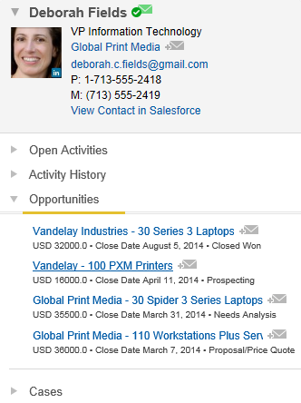
Salesforce for Outlook
Salesforce for Outlook syncs contacts, events, and tasks between Microsoft® Outlook® and Salesforce.
The side panel lets users:
View their Salesforce contact data and related records.
Add emails, events, and tasks to Salesforce records.
Create records directly from Outlook®.
Users can:
View and edit personal Outlook® configuration settings.
Select sync folders and sync method, and choose privacy options.
Assign unresolved items.
Side Panel
Search Help & Training for this online course: Using Salesforce for Outlook
RESOURCE:
Notes:
Teaching Points:
Salesforce for Outlook is an application that runs in the background on your computer and is visible in the Windows notification area.
The Salesforce side panel displays Salesforce records related to the people in your email’s To, From, and Cc fields.
View contact or lead details whenever you select or create an email, or event with invitees.
View activities, opportunities, and cases related to the displayed contact.
Click any record to go to its record detail page in Salesforce.
Add the selected email, event, or task to any of the displayed records with a single click.
Create accounts, cases, contacts, leads, opportunities, and other types of records customized for your organization.
Users can view and edit (if allowed by the administrator) their personal Outlook configuration settings. These settings determine what users can do with emails in Outlook, how data is synced, and what data is synced.
Users can specify their sync method:
Manual—Only items that are manually assigned the “Sync with Salesforce” category will sync.
Automatic—All items will sync unless users manually assign them the “Don’t Sync with Saleforce” category.
Users can choose to include private contacts, events, or tasks.
Unresolved items are contacts, events, tasks, or emails from Outlook that have not been automatically assigned to records in Salesforce. Users can manually assign these items to Salesforce records.

Slide 72
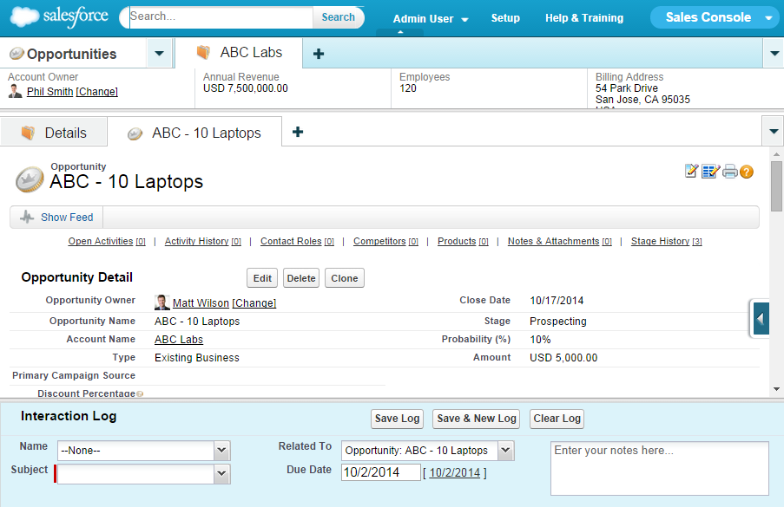
Salesforce Console for Sales
Navigation Tab
Primary Tabs
Subtabs
Highlights Panel
Interaction Log
Notes:
Teaching Points:
The Salesforce Console is available as an add-on to the Sales Cloud. The Salesforce Console for Sales is an app that is optimized for sales reps. The consolidated interface gives reps an efficient way to make contact with leads, assess companies, identify key contacts, and view their sales deals.
Let’s review the key capabilities of the Salesforce Console for Sales.
Navigation Tab: A tab with a drop-down button in a Salesforce console that lets sales reps select and view object home pages.
Primary Tab: A tab in a Salesforce console that displays the main item to work on, such as an account.
Subtab: A tab that displays content related to the item on a primary tab in a Salesforce console. For example, a primary tab showing an account might have subtabs for opportunities and contacts.
Highlights Panel: A customizable table of up to four columns and two rows that appears at the top of every primary tab in a Salesforce console. It lets sales reps view key information about records at a glance.
Interaction Log: An area in a Salesforce console where sales reps can jot notes about the record they're working on without clicking a button, viewing a new tab, or scrolling to the Notes & Attachments related list. Interaction logs are archived on the Activity History related list for easy review and retrieval.

Slide 73



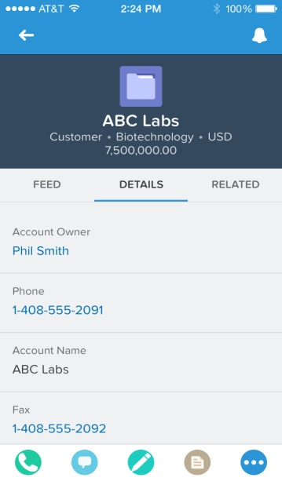
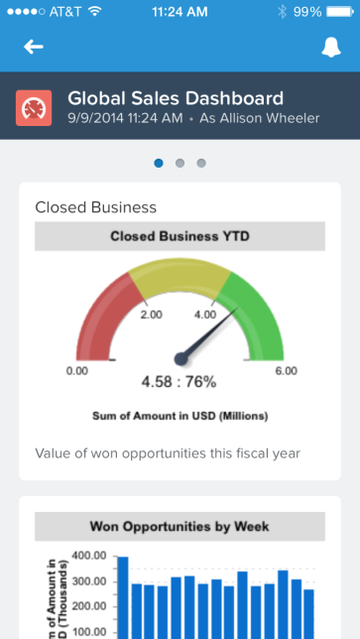


Salesforce1 Mobile App
Allows access to Salesforce from mobile devices.
NOTE:
Salesforce1 is available on:
Android smart phones and tablets with Android 4.1 or later.
iOS smart phones and tablets with iOS 7 or later.
Salesforce1 can be accessed using a mobile browser. See Help & Training for the list of supported browsers.
Notes:
Teaching Points:
The Salesforce1 App is available for Android smart phones with Android 4.1 (Jelly Bean) or later, and iOS smart phones and tablets with iOS 7 or later.
Users must have the "API Enabled" permission enabled to access Salesforce1.
Extra Materials:
If enabled, Salesforce1 can also be accessed through a mobile web browser. See Help & Training for a list of devices that support the Salesforce1 mobile browser
Suggestions:

Slide 74

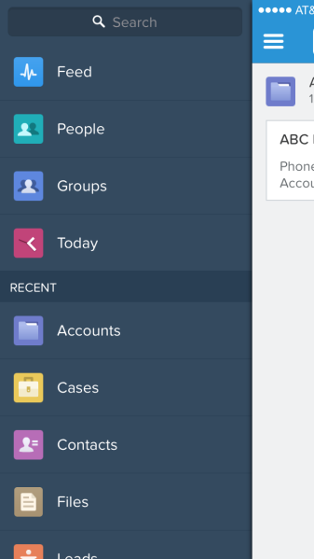

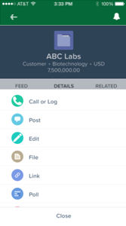

Salesforce1 Customizations
Administrators can make customizations specific to Salesforce1, including:
Change the brand color.
Brand loading page with a custom logo.
Customize compact layouts.
Add and customize the actions in the publisher.
Change the order of items listed in the navigation menu.
Notes:
Teaching Points
Most declarative customizations (page layouts, custom fields, record types, etc.) are automatically available in Salesforce1 (no configuration required). For example, when an administrator creates a custom opportunity field and adds it to the opportunity page layout, sales reps will automatically see the new opportunity field in the Salesforce1 app.
Administrators can make customizations specific to Salesforce1, including:
Change the order of items listed in the navigation menu.
Customize compact layouts to display most useful information.
Add and customize the actions in the publisher.
Customize the branding. You can change the logo on the loading page and change the brand color.

Slide 75
Collaborating with Chatter
Chatter | Capabilities
Chatter Feeds | Post comments, files, links, and polls to collaborate with other users. @mention individual people or groups to bring them into the conversation. Enable feed tracking for objects to allow collaboration on records.
Chatter Groups | Create public or private groups to collaborate with specific people. Invite customers to private groups to work with external users.
Chatter Topics | Add topics to Chatter posts to organize them and increase their visibility. Add topics to records to group them by a common theme, and then use those topics to filter list views. Search for topics and view all posts about a specific topic. Find and endorse people knowledgeable about a topic. Run reports on Chatter topics associated to records
Notes:
Teaching Points:
Topics are words or phrases that you can associate with Chatter Posts and Salesforce records to organize them around common themes.
Here is an example of how you might use Chatter topics on records: If a number of accounts are participating in a conference, you might add the topic User Conference to their records. You could then use that topic to filter an accounts list view.
Extra Materials:
Chatter does not need to be enabled to use topics on records.
Administrators can enable topics for accounts, assets, campaigns, cases, contacts, contracts, events, leads, opportunities, tasks, and custom objects.
Suggestions:
Have students come up with sales productivity use cases for Chatter Feeds, Chatter Groups, and Chatter Topics.

Slide 76
Salesforce CRM Content vs. Chatter Files
Capability | Salesforce CRM Content | Chatter Files
Searching | Search for files by keywords. Filter search results by file format, featured content, author, tag, or libraries. | Search for files by keywords. Filter by your files and files in your groups.
Sharing with Coworkers | Create a library to store files and add users as members. Use library permissions to control what users can do, such as add, delete, and archive content. Users can subscribe to files, tags, authors, and libraries to receive email notifications. | Share with people and groups by editing the file sharing settings. Users can follow files to receive updates in their feed.
Sharing with Customers | Create a content delivery and send the encrypted URL to let customers view an online version of a file. Track how often content is viewed or downloaded. Control if users can download the file. Password protect the file. Set a viewing expiration date. | Share with customers by editing the file sharing settings and clicking Anyone with link. Send the link to customers to allow them to view and download the file. Invite customers to private Chatter groups and share files to the group.
Notes:
Teaching Points:
By default, Chatter files are Private.
To subscribe to a file, content pack, Web link, or Google doc, view its content details page and click Not Subscribed. From the content details page you can also subscribe to a tag, author, or library by using the drop-down menus next to the tag, author, or library name.
Subscriptions generate the following email notifications:
If you subscribe to a file, you are notified when a viewer adds comments to the file or when a new version of the file is published. If you subscribe to a Web link or Google doc, you are notified when comments are added but not when the link is changed or the doc is edited.
If you subscribe to a content pack you are notified when a new version of the pack is published. Unless you are subscribed to the individual files within a content pack, you are not notified when new versions of the files are published.
If you subscribe to a tag, you are notified of any newly published content that is associated to the subscribed tag. To be notified that new versions of the tagged content are available, subscribe to the content.
If you subscribe to an author, you are notified when the author publishes new content. To be notified that new versions of an author's content are available, subscribe to the content.
If you subscribe to a library, you are notified when new content is added to the library, including existing content that has been newly linked to your subscribed library. To be notified that new versions of the library content are available, subscribe to the content.

Slide 77
What Solution Would You Recommend?
Sales reps need to share information on competitors.
The sales team wants to share sensitive documents with a key customer. They want to prevent customers from downloading and distributing these files.
Sales reps need to share documents with team members who are working on their opportunities.
Sales reps need to easily find people who are experts in specific product areas.
Sales reps need to automatically log emails as activities on opportunity records.
Solution:
Solution:
Solution:
Solution:
Solution:
Notes:
Teaching Points:
For each business requirement, ask the students what elements they would include in a solution. This may be a discussion about what considerations and factors should be considered in cases where there are multiple potential solutions.
Requirement: Sales reps need to share information on competitors.
Solution: Use Chatter groups to share information and files on competitors.
Requirement: The sales team wants to share sensitive documents with a key customer. They want to prevent customers from downloading and distributing these files.
Solution:
Upload the files to Content.
Create a content delivery and send the encrypted URL.
Disable the ability to download the files.
Password protect the file for added security.
Set a viewing expiration date for added security.
Requirement: Sales reps need to share documents with team members who are working on their opportunities.
Solution: Enable feed tracking on the opportunity object and upload files to the opportunity Chatter feed.
Requirement: Sales reps need to easily find people who are experts in specific product areas.
Solution: Use Chatter Topics to find people knowledgeable about a topic.
Requirement: Sales reps need to automatically log emails as activities on opportunity records.
Solution: Use Email to Salesforce to automatically log emails you send from third-party email accounts as activities on leads, contacts, opportunities, and other records in Salesforce.
After Email to Salesforce is activated, users can access the My Email to Salesforce page to view their unique Email to Salesforce address and customize their settings.
When composing, forwarding, or replying to email, simply enter your Email to Salesforce address in the BCC field or any recipient field.
Salesforce receives a copy of the email and, depending on your configuration, adds it to either the Activity History related list of the matching records or to the My Unresolved Items page, where you can manually assign it.

Slide 78
Module 6:
Integration and Data Management

Slide 79
Exam Objectives Covered in this Section
Integration and Data Management
Explain the use cases and considerations for data migration in Sales Cloud.
Given a scenario, analyze the implications and design considerations of large data and transaction volumes.
Explain the use cases and considerations for integrations common to Sales Cloud implementations.
Communities and Site Management
Explain the use cases for Communities and sites in the sales process.

Slide 80


Integration and Data Management
As we roll out Sales Cloud, we’ll first migrate data from legacy systems, and then integrate our on-premise systems with Salesforce.
John Wiseman
CEO
Notes:
Suggestions:
Ask the students what questions they might ask the client around data management and integrations.
Potential discovery questions:
What type of information do you want to migrate into Salesforce?
What data migration concerns do you have? Who will you talk to in order to address them?
What data needs to be migrated?
Does the data need to be cleaned or transformed before it is imported?
Will you continue to use the other system?

Slide 81
Steps Leading to a Successful Data Migration
Choose the data
Export data
Clean up the data
Choose an import tool
Prepare the import file
Configure Salesforce
Test the import
Select the data to be imported.
Export data to necessary format.
Eliminate duplicates and errors.
Decide which data loading tool is most appropriate for your data.
Match field names to Salesforce field names to map data upon import.
Determine how migration will impact performance.
Import a small batch or test the import into a sandbox environment.
When importing data, the master or parent record must be imported first, before importing the detail or child record.
NOTE:
Notes:
Teaching Points:
This is a high-level view of the stages and steps in a data migration.

Slide 82
Data Migration Tools
Tool | Capabilities
Data Import Wizard | Up to 50,000 records Accounts, contacts, leads, solutions, and custom objects Prevents duplicates by checking specified fields during upload
Data Loader | Up to 5M records Any standard or custom object Insert, update, delete, export, or upsert records Schedule regular data loads (e.g., nightly imports) User interface wizard or command-line configuration
Bulk API | Up to 50M records in a 24-hour period Optimized for processing large sets of data Any standard or custom object Programmatic access to load data asynchronously
3rd Party Tools | Variety of tools offered by partners Capabilities and data limits vary
Notes:
Teaching Points:
Please note that data load limit numbers change by release – understand the general limitations of the tools, and verify numbers as needed.
There is a Data Import Wizard for Accounts and Contacts, Person Accounts, Leads, Solutions, and Custom Objects.
The Data Loader can be configured to work with the Bulk API for large loads.
The Bulk API is most efficient when used for large loads over 1 million records. The 50M limit is based on API limits of up to 5K batches a day of no more than 10K records each.

Slide 83

Loading Data
Best practices when loading data:
Clean and organize data before loading.
Search for tools on the AppExchange.
Use the Bulk API for better throughput.
Disable actions that fire on insert (triggers, validations, and workflow).
SUCCESS BOOST!
Notes:
Teaching Points:
Clean and organize: take extra care that the data is clean to begin with, including relationships between parent and child objects.
Search the AppExchange for data load utilities that can improve ETL processes. Many of these utilities are free and leverage the Bulk API.
Use the Force.com Bulk API to load lots of data quickly into Force.com. You can also use it to remove large sets of data from your org, quickly and efficiently.
Disable processes like validation rules, workflow rules, and triggers, which can add substantial time to inserts. (When you know you’re inserting clean data!)

Slide 84

Working with Large Data Volumes
Considerations when loading large volumes of data:
Defer sharing calculations until after the load is complete.
Data skew (1:10K parent to child records)
Ownership skew (1:10K owner to number of records)
Performance considerations for systems with large data volumes:
Reporting
Dashboard refreshes
Searches
List views
Best practice: If a single user owns more than 10,000 records, the user record of the owner should not hold a role in the role hierarchy.
ALERT:
Notes:
Teaching Points:
Sharing calculations can take a considerable amount of time when inserting lots of data into an org that’s already configured. By deferring these sharing calculations until after the load is complete, you can reduce load times.
**Note: after you have deferred sharing and loaded your data, you need to resume normal sharing calculations and recalculate sharing rules.
If you have implemented teams or Territory Management and have more than two million accounts, you especially need to pay attention to performance. These are complex sharing model components that can make for a huge volume of share records and hence, long running transactions.
Data skews are defined as a few parent records with many children records. E.G., when a few accounts have many contacts, opportunities, or cases.
Ownership skews are similar to data skews; it refers to a single user, role, or group owning a large number of records for an object.
Skews can cause long running transactions, causing a performance degradation when change occurs.
The recommended ratio is 1:10,000 (but lower is better).
If a single user owns more than 10,000 records, as a best practice:
• The user record of the owner should not hold a role in the role hierarchy.
• If the owner's user record must hold a role, the role should be at the top of the hierarchy in its own branch of the role hierarchy.

Slide 85
What Solution Would You Recommend?
A client noticed that reporting slowed down once they increased the volume of data in their system. They want to improve their system performance.
A client needs to migrate 1.5M records from a legacy system into Salesforce.
A client wants to delete 10,000 Position records from Salesforce.
Solution:
Solution:
Solution:
Notes:
Teaching Points:
For each business requirement, ask the students what elements they would include in a solution. This may be a discussion about what considerations and factors should be considered in cases where there are multiple potential solutions.
Requirement: A client noticed that reporting slowed down once they increased the volume of data in their system. They want to improve their system performance.
Solution: To maximize performance in deployments with large data volumes:
• Make queries selective—ensure that reports, list views, and SOQL are using appropriate filters.
• Reduce the amount of active data—use archiving, mashups, and other techniques to reduce the amount of data stored in Salesforce.
Requirement: A client needs to migrate 1.5M records from a legacy system into Salesforce.
Solution: Use the Bulk API when you have over 1M records or for time-sensitive loads that can take advantage of very large batches.
Requirement: A client wants to delete 10,000 Position records from Salesforce.
Solution: Data Loader

Slide 86
Options for Integrating with Force.com
The APIs
Interfaces for integrations to and from Salesforce.
Used with standard technologies such as .NET, Java, PHP, Flex, etc., to query and manipulate Salesforce data and metadata.
Apex
Force.com platform’s object-oriented on-demand programming language
Visualforce
Force.com platform’s page markup language
Additional Mechanisms (e.g., Email services, Outbound Messaging, Salesforce to Salesforce, Force.com Canvas, Mobile frameworks, SAML, OAuth)
A variety of options that have some pre-built declarative configuration.
Specialized Integrations (e.g., Open CTI, Salesforce for Outlook, Force.com Toolkit for Facebook)
Pre-built connectors to common systems
Notes:
Teaching Points:
What characteristics of your requirements will help you determine the appropriate Salesforce mechanism to use to meet your needs?
What Salesforce integration mechanisms will help you meet your requirements?
Consider:
Direction of the integration (inbound or outbound)
Time-sensitivity: synchronous or asynchronous?
Will the integration be automated, scheduled, or ad hoc?

Slide 87

Salesforce Communities
We’re updating our legacy customer-facing website. We also need to work closely with partners in the sales process.
Allison Wheeler
VP of Sales
Notes:
Suggestions:
Ask the students what questions they might ask the client around communities.
Potential discovery questions:
How do you currently engage with customers?
What Salesforce information do you need to share with partners?

Slide 88
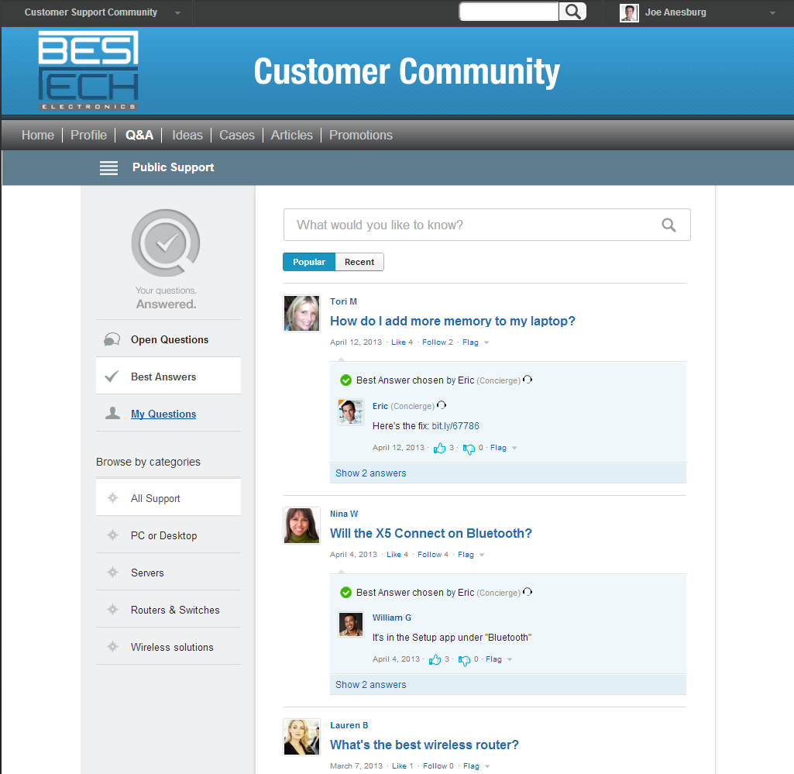
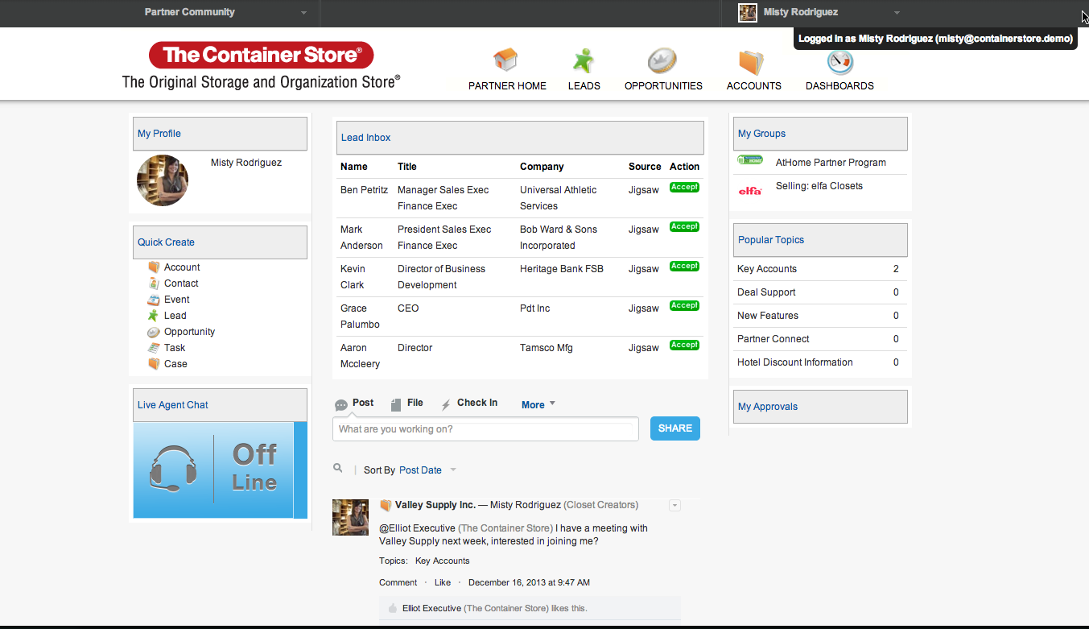

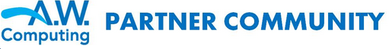

Creating Communities for Customers and Partners
Miriam Martinez | IT Director | Universal Containers | Data.com
Hugh MacPherson | Purchasing Mgr | Saginaw School District | Data.com
Raj Patel | CTO | Heritage Information Systems | Data.com
Kate Manchester | Comptroller | PDI, Inc | Data.com
Frank Columbo | Big Cheese | Salesforce | Data.com
Customer Community:
Customers can ask questions, give feedback, and contribute ideas.
Self-service support for customers saves time and money.
Partner Community:
Fosters collaboration between internal sales and partner resellers.
Efficient source of answers for partners.
Notes:
Teaching Points:
Salesforce Communities are an online platform that enables collaboration between employees, customers, and partners.
You can create fully-branded public or private communities.
Communities give external members access to subsets of your data.
External members have user records, profiles, and roles that control access to features and data.
Communities fully integrate with your internal business processes.

Slide 89
Inform and Engage Partners with a Partner Community
Partners and employees can share leads and work together on opportunities.
Name | Title | Company | Source | Action
Miriam Martinez | IT Director | Universal Containers | Data.com
Hugh MacPherson | Purchasing Mgr | Saginaw School District | Data.com
Raj Patel | CTO | Heritage Information Systems | Data.com
Kate Manchester | Comptroller | PDI, Inc | Data.com
Frank Columbo | Security Dir | SoundBites Inc | Data.com
Accept
Selling: Spider Laptops
Accept
Accept
Accept
Accept
Notes:
Teaching Points
A partner community gives partners a place to manage customer accounts, find support articles, submit and track cases, and view reports and dashboards.
Communities can provide access to the data in your Salesforce community, like leads, opportunities, and quotes.
Data access in a community is controlled by the same security model that controls access for internal users using profiles and roles.
Administrators assign community users a special community profile which determines what tabs and features the user can access.
In addition, your admin can assign a partner user a special community role to control which records they can access. This role is part of your organization’s role hierarchy.
To prevent external members from having access to data they shouldn’t, it’s important to review your Community’s security settings.

Slide 90








Control Data Access within Communities
Using Partner Roles
Using User Visibility Settings
An administrator can create a role hierarchy within a partner account.
An administrator can control external and internal user visibility.
Account Owner
Partner Role: Executive
Manager
User
User Sharing enables you to show or hide users from other users.
Your communities can be made as open or as restrictive as you require.
NOTE:
Notes:
Teaching Notes
There are different ways to restrict visibility of information within Communities.
Using Partner roles:
Within a partner account, administrators can create a role hierarchy that controls users’ access to data, similar to a user role hierarchy in Salesforce.
When partners are added to a community, they are given a contact record related to the partner account, enabled as partner users, and then assigned a partner role which determines what records they have access to.
The Partner User roles are subordinate to the partner account owner, so the account owner has access to all records owned by the partner users in the account.
User Visibility Settings:
User Sharing enables you to show or hide an internal or external user from another user in your organization.
By default, an external user can see other external users under the same account and in common communities.
You can change the organization-wide default for the User object to make your communities more restrictive or open, depending on your needs.

Slide 91


Force.com Sites
Allow you to create public websites that can display and create Salesforce data.
Can be used with Salesforce communities.
Can create both authenticated and unauthenticated websites.
Built entirely with Visualforce pages.
Notes:
Teaching Points:
Force.com Sites enables developers to build and deploy public (or non-authenticated) websites using Visualforce. These websites are built entirely with Visualforce pages can be accessed from branded domain names.
Sites leverages the data and business processes that reside in your Salesforce org.
Sites can be used with communities and authenticated sites.
Security and permission settings are maintained, including IP login hours.
Extra Materials:
Site.com and Force.com Sites can be enabled in a developer org for testing and experimentation.
Examples of sites running on Force.com Sites can be found at: http://developer.force.com/sitesgallery

Slide 92
Practice Test

Slide 93
Let’s Practice!
You have 25 minutes to complete the test.
In order to replicate the exam environment as closely as possible, please refrain from looking at your course materials.
Notes:
From the Home tab in your org, click the Practice Test link and then click start to begin the test.

Slide 94
Exam Information
The exam is available onsite at testing centers worldwide, or online as a proctored exam.
60 multiple-choice questions
1 hour 45 minutes to complete the exam
68% is the passing score
Available in 4 languages including English, Spanish, Portuguese and Japanese
No hard-copy or online materials may be referenced during the exam.
Study Guide:
http://certification.salesforce.com/SG_CertifiedSalesCloudConsultant.pdf

Slide 96

What’s Next?
Thank you for attending!
Your satisfaction is very important to us. Click on the Course Survey link located on the Home Page of your training org to give us your feedback.
Get certified! Go to www.webassessor.com/salesforce to register.
Take the next step! Register for the next course! Go to www.salesforce.com/training.
Notes:
Example slide. Included as a place to help you get ideas of things that have been done in other decks.

Slide 97




Training and Certification Resources
Training Webpage: www.salesforce.com/training
Certification Webpage: certification.salesforce.com
Follow us on Twitter: @SalesforceU
Salesforce Success Community:
Log in to Salesforce → Help & Training → Collaboration
© Copyright 2016 salesforce.com, inc. All rights reserved. Various trademarks held by their respective owners.
Notes:
Example slide. Included as a place to help you get ideas of things that have been done in other decks.

Slide 98
Volunteer with Taproot
Use your consulting skills to help nonprofit customers be successful. Check out the link below for more information.
Pro Bono Volunteers
Get practical experience in the app
Gain customer-facing experience
Learn about a new market segment
Expand their resume
Nonprofit Customers
Gain access to skilled consultants
Have successful implementations
Learn from the pros
Have more mission impact
Pro
Bono Volunteering
https://www.taprootfoundation.org/do-probono/individuals
CLICK PATH:
Notes:
Teaching Points:
The Taproot Foundation connects nonprofits and social change organizations with passionate, skilled volunteers who share their expertise pro bono. Through our programs, business professionals deliver marketing, strategy, HR, and IT solutions that organizations need to achieve their missions.
You can use your admin skills to provide a very valuable (free) consulting service to nonprofits. There is a great demand for pro bono service in the nonprofit sector and many nonprofits who would greatly benefit from a skilled admin to help with initial implementation, business requirements, configuration or training.
You benefit as well. Helping a nonprofit can also ready you for your admin test, allow you to gain customer-facing experience and give you insight into a new market segment. Check out the link on the slide for more information.

